Slide 1
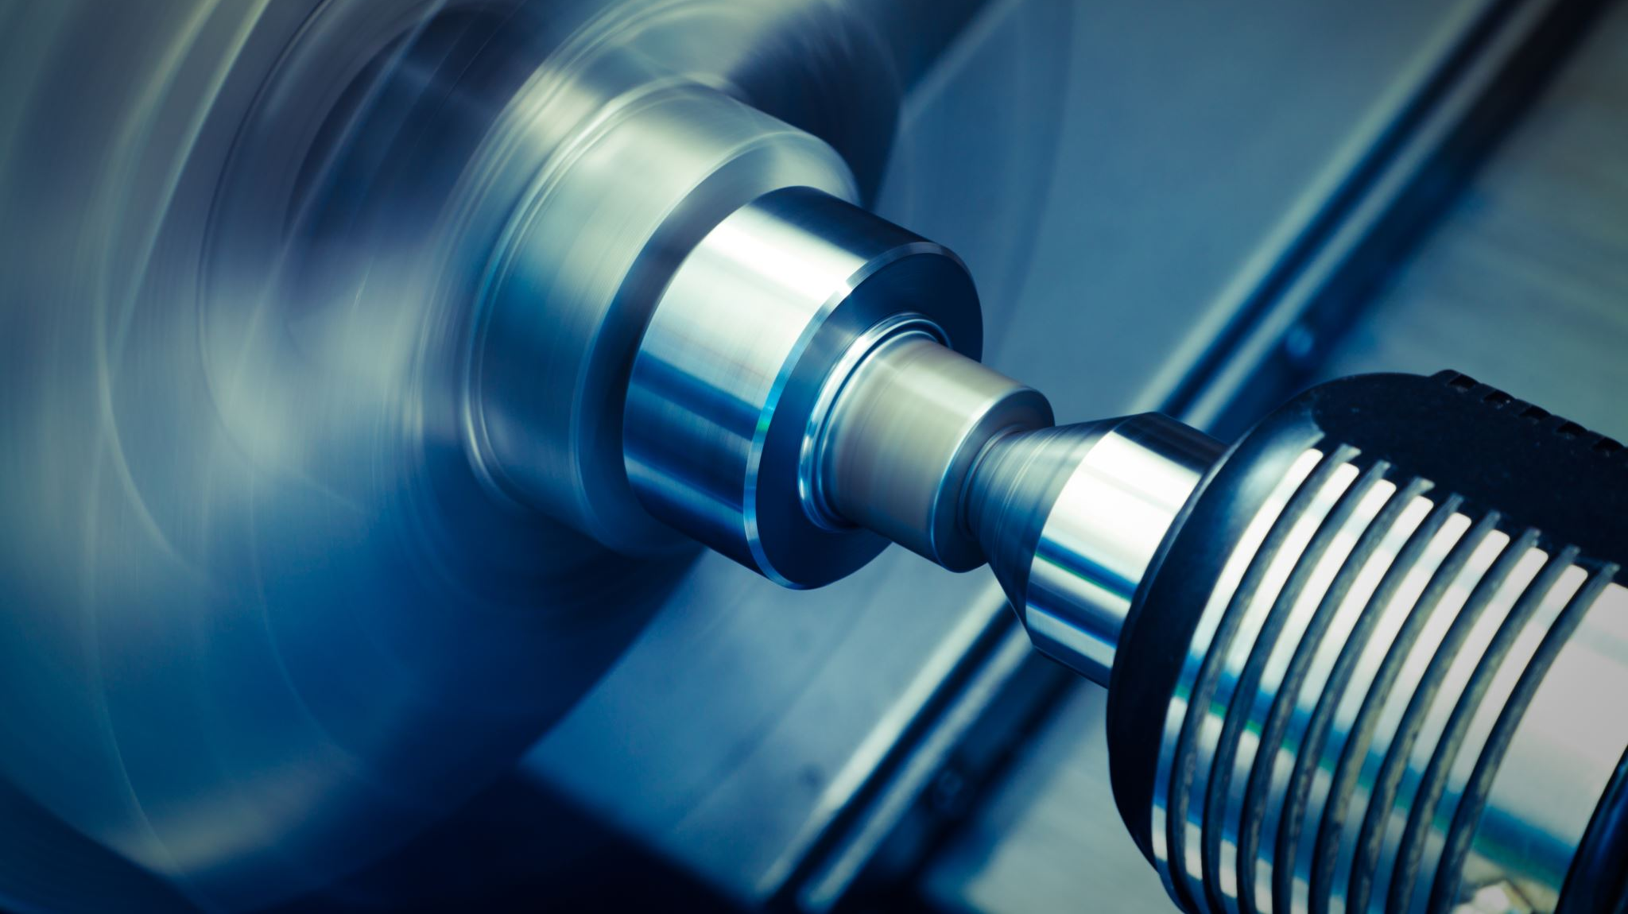
Machine failure prediction
Hagar El-Bayuomy

Slide 2
Table of content
Introduction
Data exploration
Data preprocessing
Feature engineering
Scaling features
Model Selection
Model Training and Evaluation
ROC Curve Analysis
Dataset overview
Final Result
Feature Importance Analysis

Slide 3

1 Introduction
The project aimed to predict machine failures without knowing the specific failure mode. With a dataset comprising 10,000 rows and 14 columns, the focus was on key features such as Air Temperature, Process Temperature, Rotational Speed, Torque, and Tool Wear. The objective was to develop models that accurately predict machine failures based on these features.

Slide 4

2 Dataset overview
Data Points: 10,000 rows
Key Features:
Air Temperature [K]
Process Temperature [K]
Rotational Speed [rpm]
Torque [Nm]
Tool Wear [min]
Target Variable: Machine Failure Label (Binary: 1 - Failure, 0 - No Failure)

Slide 5

3 Data exploration
3.1 Data Inspection
Checked the structure of the dataset using functions like head(), info(), and describe() to understand the types of variables, missing values, and basic statistics.
Checked null values by using isnull().sum() function to calculate the null values on each column
Check for duplicates across all cloumns by using .duplicated()
3.2 Preliminary Observations
Identified key variables such a Air Temperature [K],Process Temperature [K],Rotational Speed [rpm],Torque [Nm] And Tool Wear [min] as primary areas of interest for analysis.

Slide 6
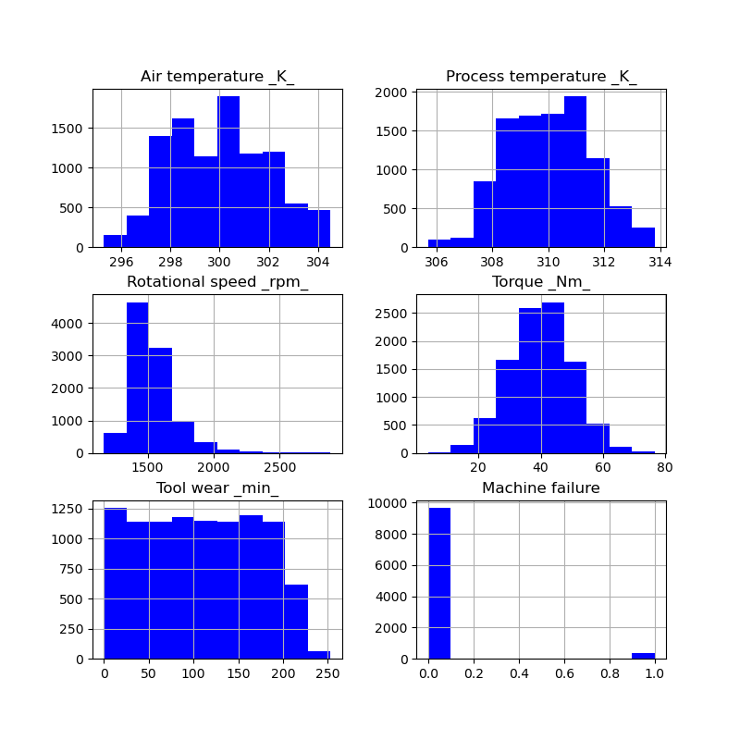
Initial exploration for the targeted classes

Slide 7
4 Data Preprocessing
Deleted unnecessary columns
data.drop(["UDI", "Product ID","RNF","OSF","PWF","HDF","TWF"], axis=1, inplace=True)
Changed cloumns name to delete [,]
Data.columns = data.columns.str.replace('[', '_').str.replace(']', '_').str.replace('<', '_’)
Handled Categorical Variables
data = pd.get_dummies(data, columns=['Type'], drop_first=True)

Slide 8
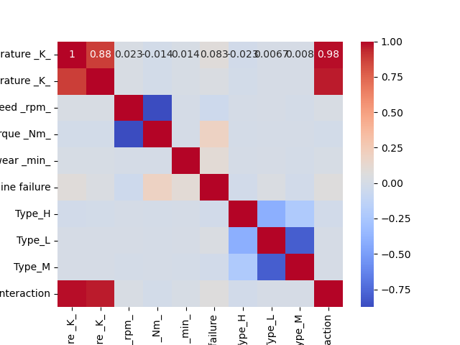
5 Feature engineering
Creating an interaction feature to increase the accuracy of the model
data['Temperature Interaction'] = data['Air temperature _K_'] * data['Process temperature _K_’]
Correlation Analysis
correlation_matrix = data.corr()sns.heatmap(correlation_matrix, annot=True, cmap='coolwarm')plt.show()

Slide 9

6 Scaling features
Standardization (Z-score normalization):
Scales the features to have a mean of 0 and a standard deviation of 1.
Assumes that the data follows a normal distribution.
Can be useful when the algorithm (XGBoost in this case) benefits from having features with similar scales.
columns_to_standardize = ['Air temperature _K_', 'Process temperature _K_', 'Rotational speed _rpm_', 'Torque _Nm_', 'Tool wear _min_']scaler = StandardScaler()data[columns_to_standardize] = scaler.fit_transform(data[columns_to_standardize])

Slide 10

7 Model selection
Models chosen for prediction were XGBoost,Random forest and Support Vector Machine (SVM). The selection was based on the models' suitability for binary classification tasks and their ability to handle complex relationships.

Slide 11
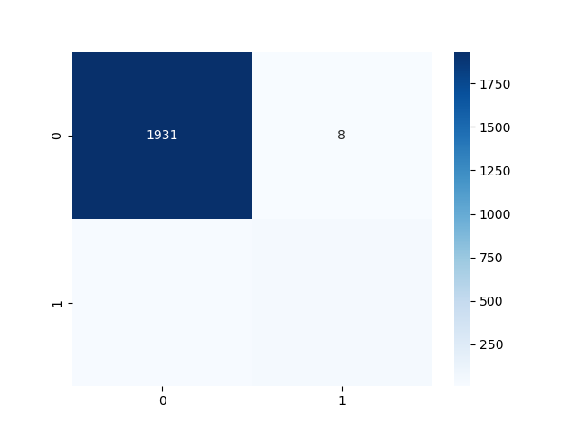
8 Model training and evaluation
XGBoost Model
Training Process: The XGBoost model was trained on the dataset.
Accuracy:0.99

Slide 12
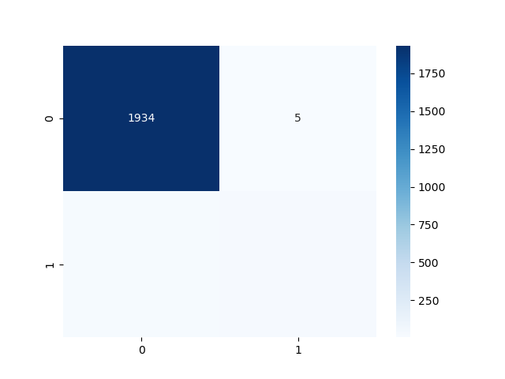
Model training and evaluation (CONT.)
0.984
Random forest model
Training Process: The random forest model was trained on the dataset.
Accuracy:0.984

Slide 13
Model training and evaluation (CONT.)
SVM Model
Training Process: The SVM model was trained on the dataset.
Accuracy:0.9695

Slide 14
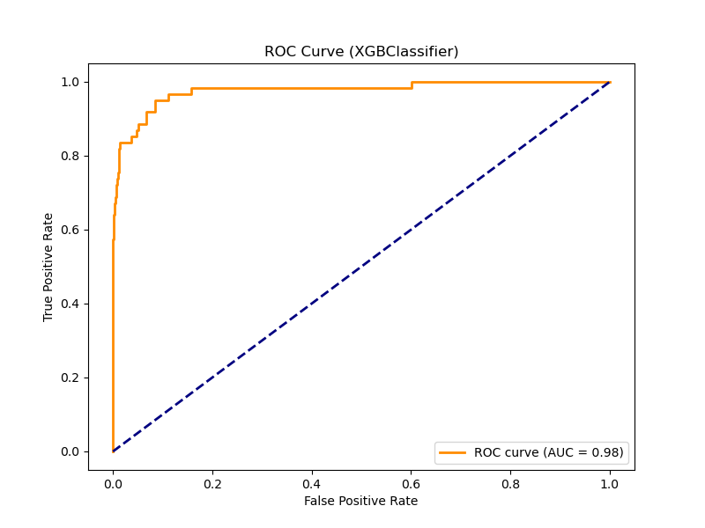
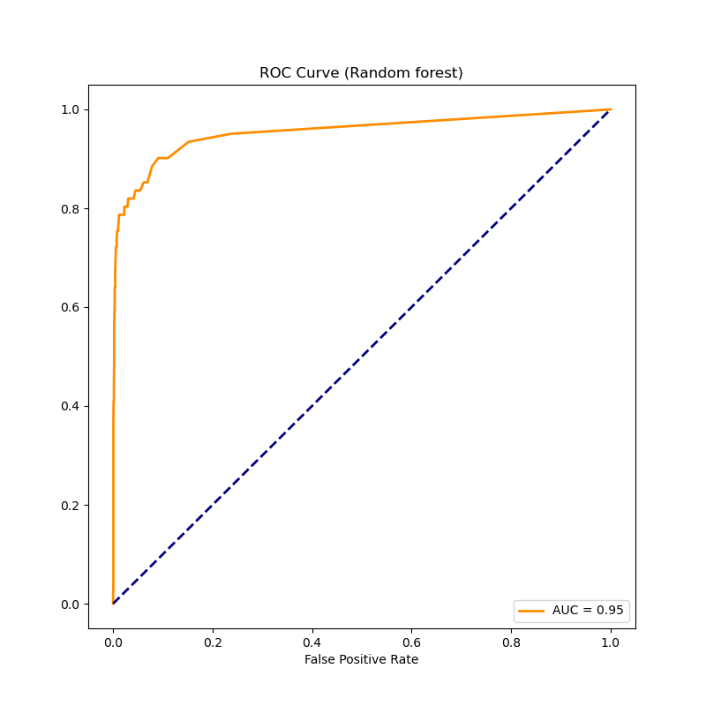
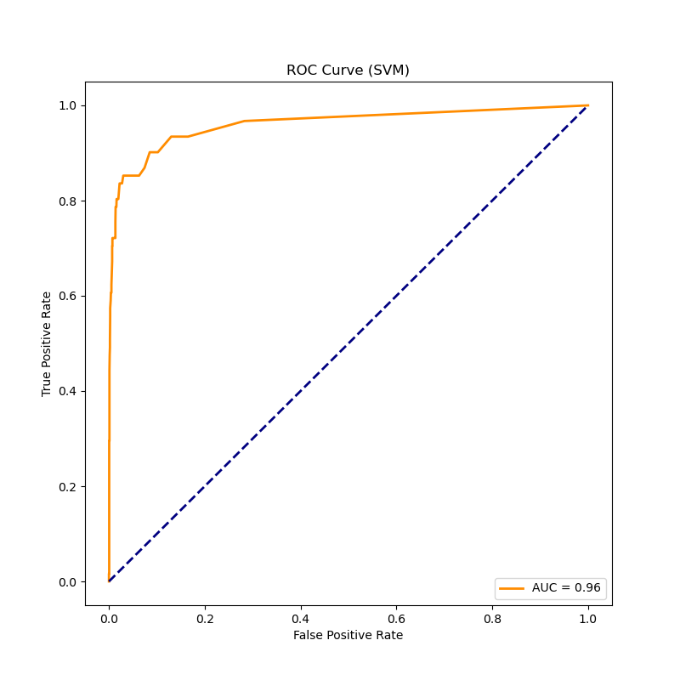
9 ROC Curve analysis

Slide 15

10 Feature Importance Analysis
A comparative analysis was conducted to assess the performance of the XGBoost,random forest and SVM models. Insights into feature importance were derived to understand factors contributing to machine failures.
Torque (Nm): 19.02%
Air Temperature (K): 17.35%
Process Temperature (K): 14.99%
Tool Wear (min): 13.36%
Rotational Speed (rpm): 12.66%
Type_L: 12.06%
Type_M: 4.47%
Temperature Interaction: 4.13%
Type_H: 1.96%

Slide 16

11 Final Result
These results emphasize the significance of Torque, Air Temperature, and Process Temperature in influencing the model's predictions. Additionally, the machine failure prediction is also influenced by the product type, with Type_L having a notable impact.

Slide 17
Thanks

